Slide 1
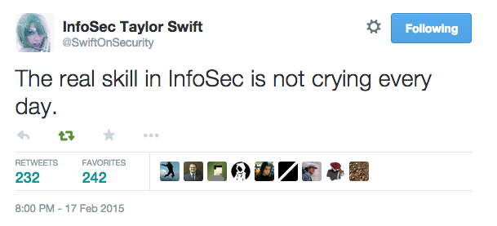
https://twitter.com/SwiftOnSecurity/status/567851173547401216

Slide 2

Defense in Depth: Firewalls

Slide 3
What is a Firewall?
A device or program that analyzes network packets and makes a decision to allow or deny that packet based on the attributes or contents of that packet.

Slide 4
What is a Firewall?
First generation: Packet filtering
Filters based on source/destination IP, source/destination port, protocol
Not aware of which end of the connection is the client or the server

Slide 5
What is a Firewall?
Second generation: Stateful filtering
Filters on the same attributes but also knows which host is the client vs server
Can tell which state a TCP connection is

Slide 6
What is a Firewall?
Third generation: Application layer
Adds inspection of application and protocol level parts of the packet
“Deep packet inspection”

Slide 7
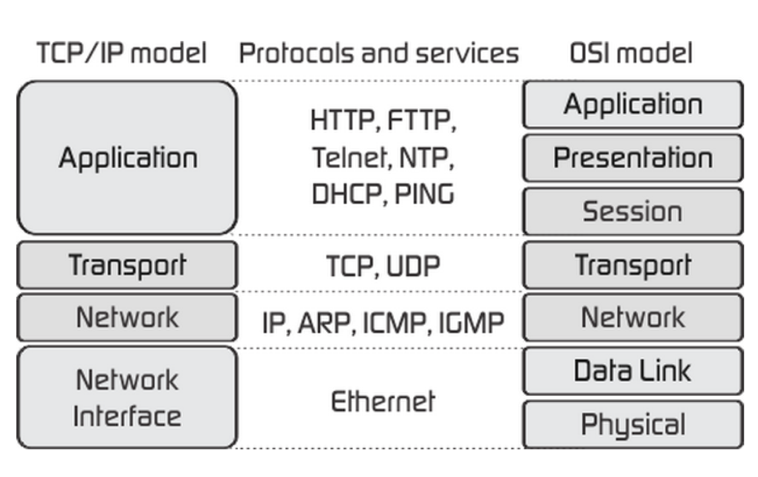
What is a Firewall?

Slide 8
Perimeter Security
Access Control Lists (ACLs)
Firewalls
Intrusion Detection/Prevention
Proxies
Network Access Control (NAC)
Bold = What we’ll cover today
Next week = IDS/IPS and Next Gen firewalls

Slide 9
Access Control Lists (ACLs)
Specifically - network access control lists
These traditionally live in routers and switches
Rules applied to IP addresses and ports
Layer 3
Similar to firewall rules, but simpler

Slide 10
ACLs – Cisco Style
access-list 10 permit ip 10.0.0.1 0.0.0.255
Notice the inverse mask of the more typical 255.255.255.0
access-list 10 deny ip any any
access-list 101 permit tcp host 10.0.0.2 host 10.1.0.1 eq 80

Slide 11
Firewalls
Network Layer packet filters
Application layer
Proxies
Network Address Translation (NAT)

Slide 12
Packet Filters
Similar to ACLs
Stateful or stateless
Filter on many attributes: Source/Dest IP, Src/Dest port, protocol
Examples: iptables, nftables, pf, Windows Firewall

Slide 13
Stateful vs Stateless?
Stateless – not aware of the traffic flow (which side is client vs server) very simple firewall and can be bypassed by forged packets
Stateful – aware of traffic streams, knows which way the traffic is flowing. Can tell stage a TCP connection is in (open, established, SYN, SYN ACK, SCK, reset)
Both have their purposes, often speed vs accuracy

Slide 14
Inbound vs Outbound
Inbound – default deny, allow only what you want in
Specific allow rules
Allow established connections in
Hard exterior
Outbound – default allow
Soft chewy inside – is this the best?
What’s the A in the CIA triad?

Slide 15

Outbound filtering 💀
Many a security person, sysadmin, and network admin have gone crazy trying to set up rules to limit what goes outbound.
It just doesn’t scale well in the era of CDNs, SaaS, and cloud

Slide 16
iptables
Primarily host-based firewall giving you very granular rules to allow/deny connections
Can be used as a cheap network firewall if you have your Linux host set up as a router
User-space application to configure the tables in the Linux kernel firewall and the chains of rules it stores
Stateful

Slide 17
IP firewalling Chains?
A “chain” is a group of firewall rules used to process and organize rules.
This grouping is used to help improve processing speed
If this packet is incoming/input why process the output rules against it?
Chains are evaluated by series of chains which can be in different order so managing large rulesets can be challenging

Slide 18
iptables
Chains
INPUT – incoming
OUTPUT – outgoing
FORWARD – for routing packets behind your box (like when using as a NAT/firewall)

Slide 19
iptables
iptables –L = list current rules
-A = Append this rule to a chain
-p tcp|udp|icmp = Connection protocol used
-j = jump to specified target (ACCEPT, REJECT, DROP, LOG)
iptables –F = Flush rules
Logs sent to either /var/log/messages or /var/log/kern.log by default (depends on Distro)

Slide 20
iptables
iptables –A INPUT –m state –state ESTABLISHED,RELATED –j ACCEPT
iptables –A INPUT –p tcp –dport ssh –j ACCEPT
iptables –A INPUT –p tcp –dport 80 –j ACCEPT
iptables –A OUTPUT –p icmp –icmp-type echo-request –j DROP

Slide 21
iptables Exercises
In the Firewall exercise document there are 3 exercises for iptables.
Take 30 minutes to run through them.

Slide 22
iptables Log Format
Feb 3 20:03:03 ubuntu kernel: [ 2922.929053] IN=ens33 OUT= MAC=00:0c:29:98:f0:3f:00:50:56:c0:00:08:08:00 SRC=192.168.2.1 DST=192.168.2.159 LEN=64 TOS=0x00 PREC=0x00 TTL=64 ID=52309 DF PROTO=TCP SPT=50865 DPT=80 WINDOW=65535 RES=0x00 SYN URGP=0
Timestamp = Feb 3 20:03:03
Hostname = ubuntu
Process = kernel
Uptime = 2922.929053
IN = if set, packet was incoming via the network adapter (ens33)
OUT = if set, packet was outgoing via the network adapter

Slide 23
iptables Log Format
Feb 3 20:03:03 ubuntu kernel: [ 2922.929053] IN=ens33 OUT= MAC=00:0c:29:98:f0:3f:00:50:56:c0:00:08:08:00 SRC=192.168.2.1 DST=192.168.2.159 LEN=64 TOS=0x00 PREC=0x00 TTL=64 ID=52309 DF PROTO=TCP SPT=50865 DPT=80 WINDOW=65535 RES=0x00 SYN URGP=0
MAC = 14 byte combo of Dest MAC, Src MAC, and EtherTypes (00:0c:29:98:f0:3f:00:50:56:c0:00:08:08:00)
SRC = Source IP (192.168.2.1)
DST = Destination IP (192.168.2.159)
LEN = Length of the packet (64)
TOS = Types of Service (IPv4 header) (0x00 )

Slide 24
iptables Log Format
Feb 3 20:03:03 ubuntu kernel: [ 2922.929053] IN=ens33 OUT= MAC=00:0c:29:98:f0:3f:00:50:56:c0:00:08:08:00 SRC=192.168.2.1 DST=192.168.2.159 LEN=64 TOS=0x00 PREC=0x00 TTL=64 ID=52309 DF PROTO=TCP SPT=50865 DPT=80 WINDOW=65535 RES=0x00 SYN URGP=0
TTL = Time to Live (64)
ID = IPv4 packet identifier (52309)
PROTO = Protocol (TCP, UDP, ICMP, etc) (TCP)
SPT = Source Port (50865)
DPT = Dest Port (80)
WINDOW = Max size of packet (65535)

Slide 25
iptables Log Format
Feb 3 20:03:03 ubuntu kernel: [ 2922.929053] IN=ens33 OUT= MAC=00:0c:29:98:f0:3f:00:50:56:c0:00:08:08:00 SRC=192.168.2.1 DST=192.168.2.159 LEN=64 TOS=0x00 PREC=0x00 TTL=64 ID=52309 DF PROTO=TCP SPT=50865 DPT=80 WINDOW=65535 RES=0x00 SYN URGP=0
RES = Reserved for future use (always set to 0) (0x00)
SYN = Synchronize, start of the TCP handshake. If there that’s what this packet was (SYN)
Could also be ACK, SYN-ACK, etc..
URGP = Is the urgent pointer set? 0 = no (0)

Slide 26
iptables Logs – What’s Important
Feb 3 20:03:03 ubuntu kernel: [ 2922.929053] IN=ens33 OUT= MAC=00:0c:29:98:f0:3f:00:50:56:c0:00:08:08:00 SRC=192.168.2.1 DST=192.168.2.159 LEN=64 TOS=0x00 PREC=0x00 TTL=64 ID=52309 DF PROTO=TCP SPT=50865 DPT=80 WINDOW=65535 RES=0x00 SYN URGP=0
Timestamp
SRC
DST
LEN
PROTO
SPT
DPT
Type of packet (SYN, ACK, SYN-ACK, etc)

Slide 27
iptables Logs – What’s Important
Timestamp – what time was it sent?
SRC – where did it come from?
DST – where was it going?
LEN – how big was it?
PROTO – how was it being sent?
SPT – what port did it come from?
DPT – what port did it go to?
Type of packet (SYN, ACK, SYN-ACK, etc) – where was it in the conversation?

Slide 28
nftables
Planned to one day replace netfilter/iptables
Added to Linux kernel in 3.13
Faster and less code duplication
User space tool to configure: nft
Block any traffic being sent to 128.8.10.90:
nft add rule ip filter output ip addr 128.8.10.90 drop
With as embedded as iptables is it’s not going anywhere anytime soon but be aware this will one day replace it

Slide 29
iptables -> nftables migration
There’s an app for that!
iptables-translate
iptables-translate -A INPUT -p tcp --dport 22
-m conntrack --ctstate NEW -j ACCEPT
Becomes
nft add rule ip filter INPUT tcp dport 22 ct state new counter accept

Slide 30
Why replace iptables?
iptables was released ~25 years ago when connection speeds were MUCH slower (most people on dialup, orgs on T1s – T3s – 1.5Mbps – 45Mbps) and what a firewall had to do a lot less:
Protect local app from receiving unwanted traffic (INPUT)
Protect local app from sending unwanted traffic (OUTPUT)
Filter/forward network traffic (FORWARD)
As network speeds rose and rulesets became far more complex managing a linear ruleset becomes inefficient

Slide 31
ufw
“Uncomplicated” firewall
Tool added in Ubuntu 8.04 to make managing iptables firewall rules easier
ufw enable
ufw status
ufw allow ssh/tcp
ufw logging on
ufw deny proto tcp from 1.2.3.4 to any port 80

Slide 32
ufw Exercise
Do the ufw exercise in the Firewall exercises document
Take 10 minutes for this

Slide 33
pf
pf = Packet Filter
Developed for OpenBSD but ported to many platforms, mostly BSD-based
pf is stateful
pf designed to be very, very fast.
Rules managed sequentially
pfctl used to change rules on the fly

Slide 34
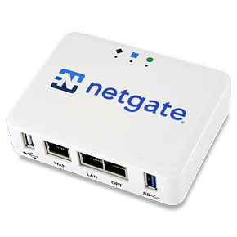
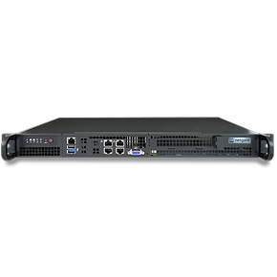
pfSense
https://www.pfsense.org/
Open source firewall/router/DHCP/DNS/VPN/IPS/etc. distribution
Based on FreeBSD
Name stems from it uses the pf packet filtering tool
Founded 2004
Open source and commercial product (NetGate) https://www.netgate.com/

Slide 35
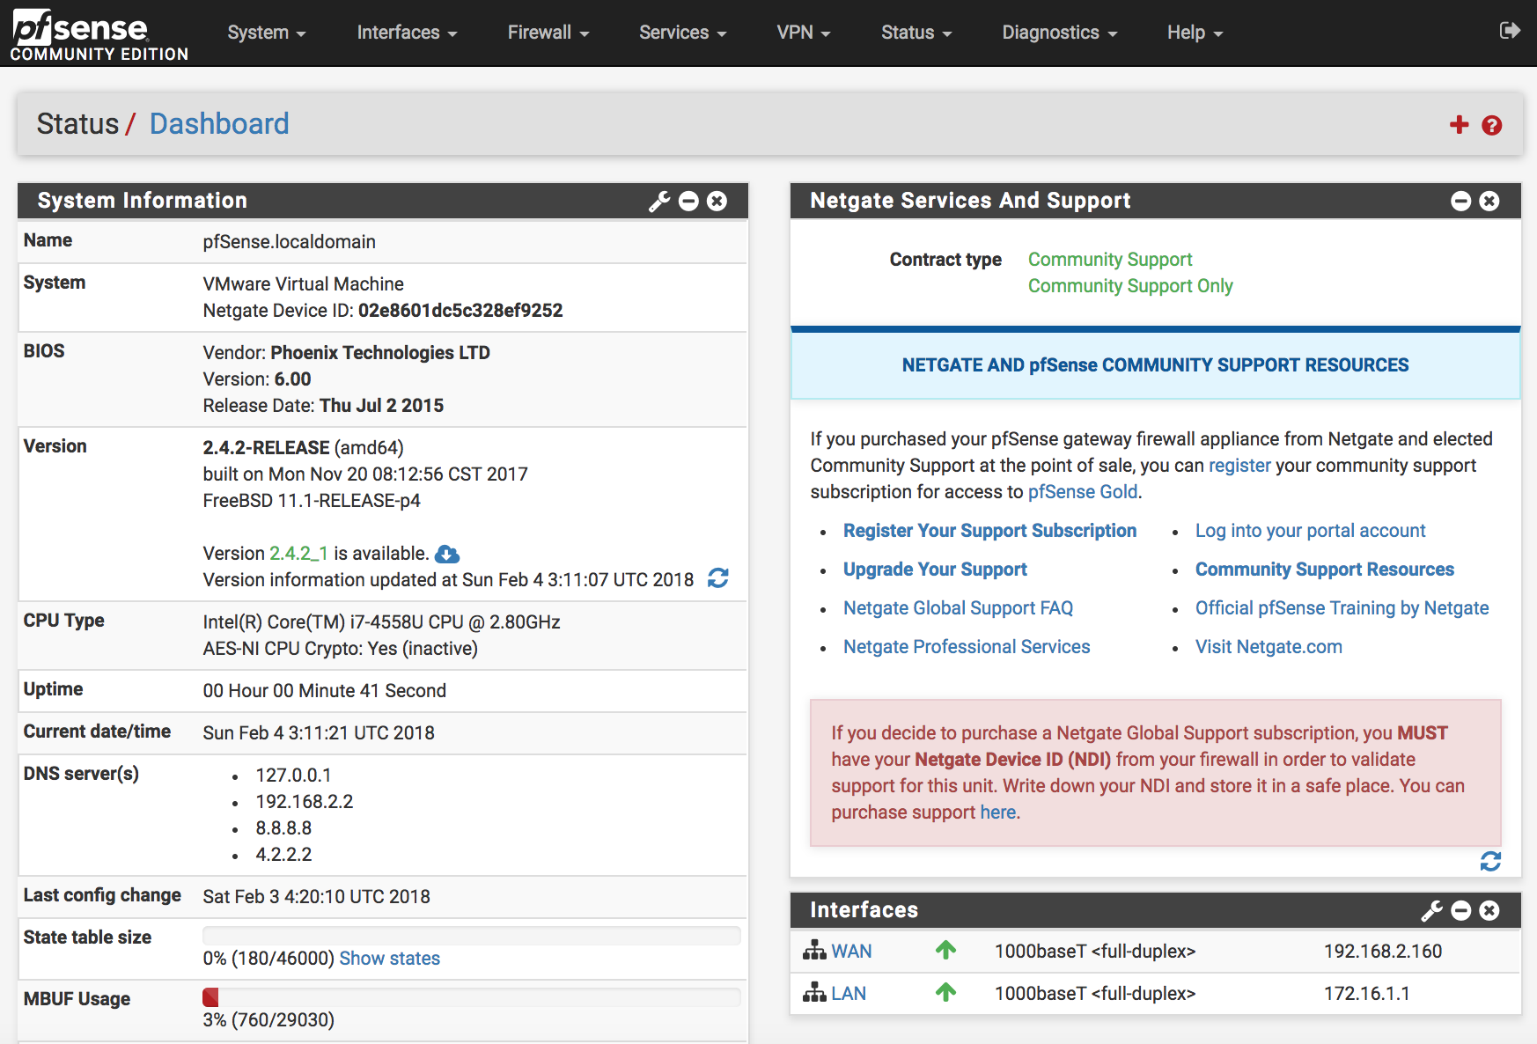

Slide 36
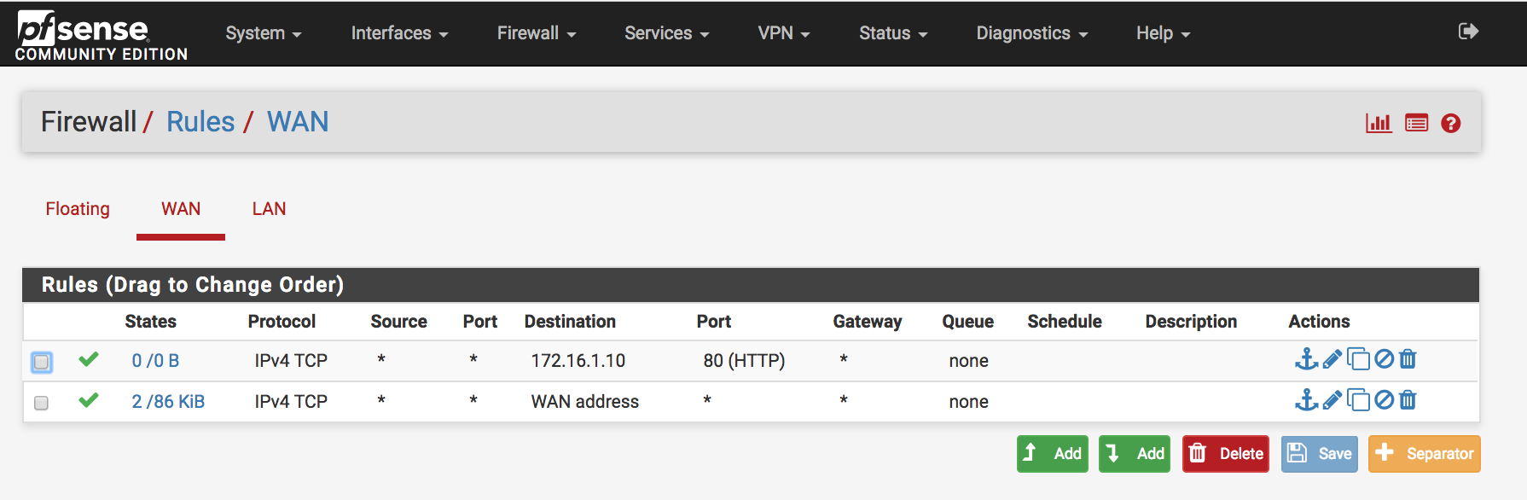

Slide 37
Optional Additional Exercise
This is an at-home exercise if you want to get more hands on with the real work open source tool, pfSense.
Follow the documentation to
Create a pfSense VM
Create an Ubuntu VM behind pfSense
Run through the pfSense exercises

Slide 38
Challenge of traditional firewalls
Blocking IPs and ports
What happens if someone changes their system’s IP address?
What happens if someone sets up an SSH server to run on a non-standard port?
What if you could block based on protocol? User? System? (More on this w NAC and NGFWs)

Slide 39
fail2ban
Monitors a variety of log files for configurable entries and runs scripts based on them, like adding an iptables rule.
SSH
Apache
FTP
Postfix and other mail servers
Scriptable allowing you great flexibility on alert
http://www.fail2ban.org/

Slide 40
fail2ban – jail.conf
/etc/fail2ban/jail.local
This is where you enable/disable settings
Ex:
[sshd]
Enabled = true
Some other important settings:
maxretry = number of times before IP is blocked
default is 5, may want to up this for production
ignoreip = IP ranges to not block Ex:
ignoreip = 127.0.0.0/8 128.8.0.0/16 129.2.0.0/16

Slide 41
fail2ban Exercise
Do the fail2ban Exercise in the Firewall Exercises document
Take 20 minutes.

Slide 42
Port Knocking
Idea where you must “knock” on a specific sequence of ports over a specific time frame, maybe even with specific packets set to “unlock” or open the port you actually want to connect to.
Hides open services to only those in the know
Mostly theoretical or a “hey look at what I can do!”
http://www.portknocking.org/view/implementations

Slide 43
Application Firewall
Network, Host, or Cloud-based
Works in Layer 7
Intercept all traffic related to a specific application and process
Inspect to improper content, malware, inappropriate destinations, etc.
Often has better logging that a web server (record cookies, content send/received)

Slide 44
Application Firewall
Most common example of this is a WAF – web application firewall
OSS Example: ModSecurity
$ Examples: Imperva, F5 Application Security Manager
Cloud Examples: CloudFlare, Akamai

Slide 45
Next-Generation Firewall (NGFW)
Features:
Stateful firewall
Application firewall (identify network protocol/application, content filtering)
Intrusion Prevention (block ”known bad”)
Features to quickly block new threats (block “unknown bad”)

Slide 46
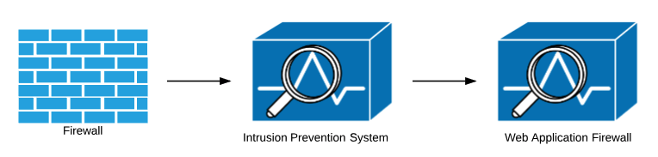
Before
Every security device is a “bump in the wire”
Latency
Interoperability issues

Slide 47
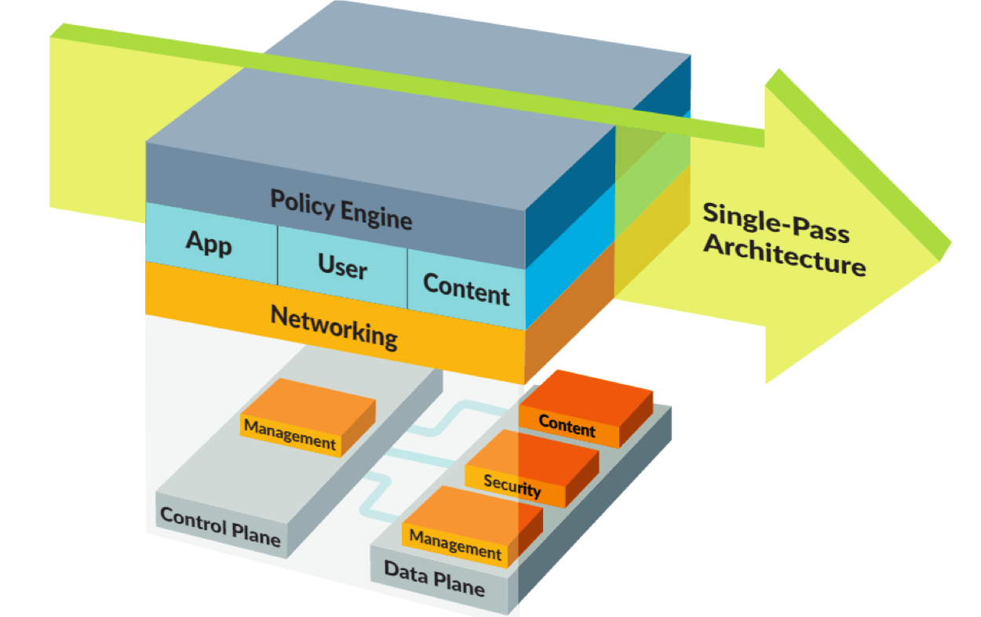
NGFW: Palo Alto

Slide 48
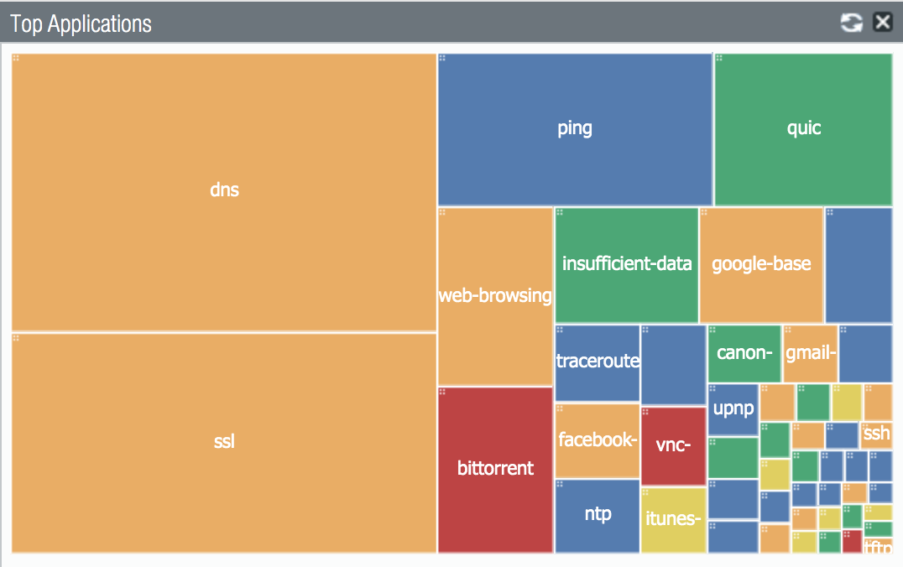

Slide 49
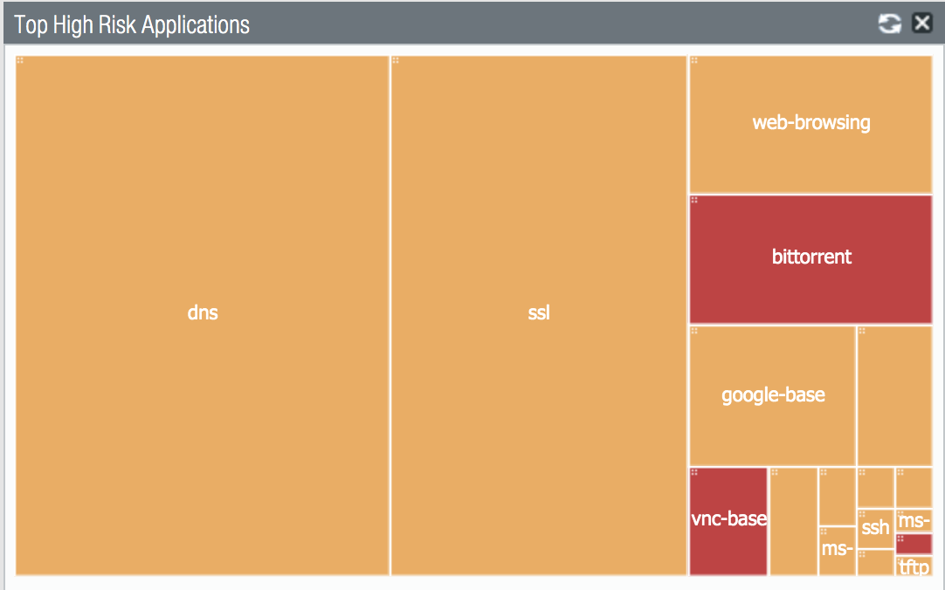

Slide 50
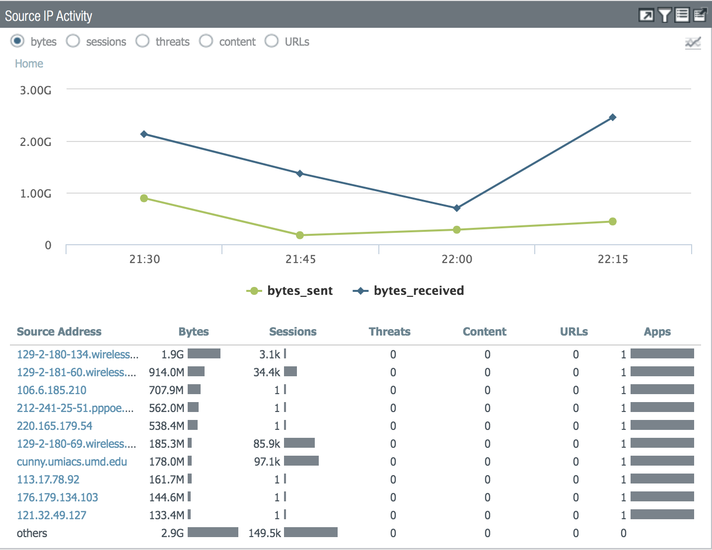

Slide 51
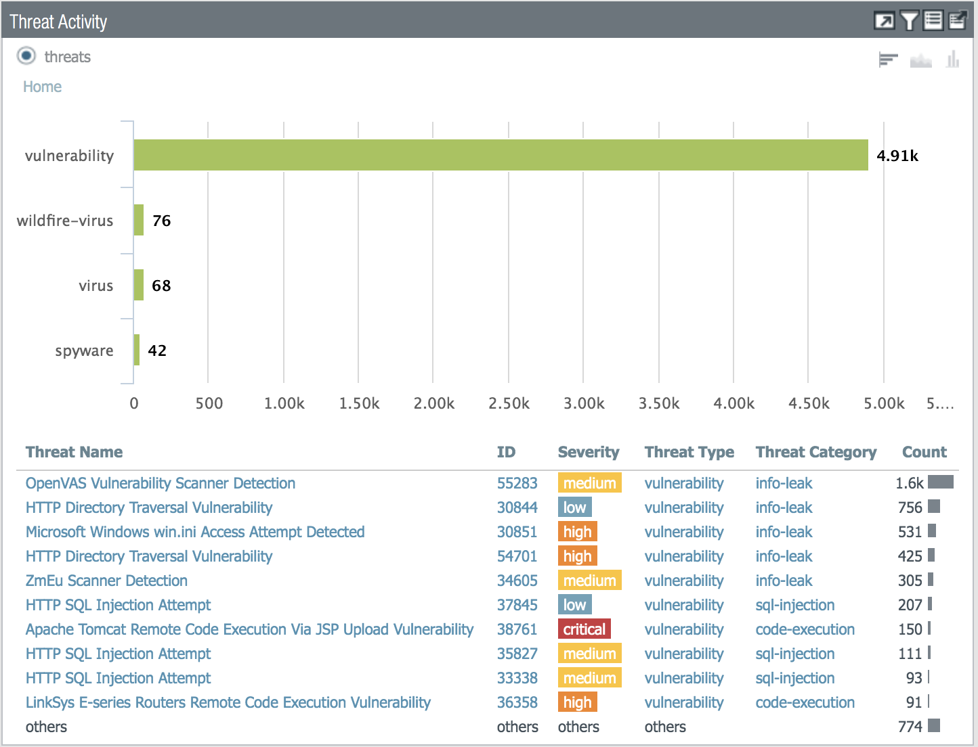

Slide 52
Palo Alto Raw Logs
Mar 7 13:15:01 css-border-pa1.umd.edu 1,2019/03/07 13:15:00,010108001031,THREAT,vulnerability,1,2019/03/07 13:15:00,23.91.70.146,129.2.35.162,0.0.0.0,0.0.0.0,Inbound Border Policy,,,web-browsing,vsys1,Border,Core,ae1,ae2,PA-7050 Syslog,2019/03/07 13:15:00,572351231,1,44891,80,0,0,0x2000,tcp,reset-both,"public-faculty-detail.php",HTTP SQL Injection Attempt(35827),any,medium,client-to-server,6642400539484418127,0x8000000000000000,United States,United States,0,,0,,,1,,,,,,,,0,11,0,0,0,,css-border-pa1,,,,,0,,0,,N/A,sql-injection,AppThreat-8130-5335,0x0

Slide 53
Palo Alto Features
Antivirus
Clear text protocols
Vulnerability protection
Detect services, OS and application vulnerability exploits
Spyware
Malicious domains -> Sinkhole
Malicious IP
Command and control traffic

Slide 54
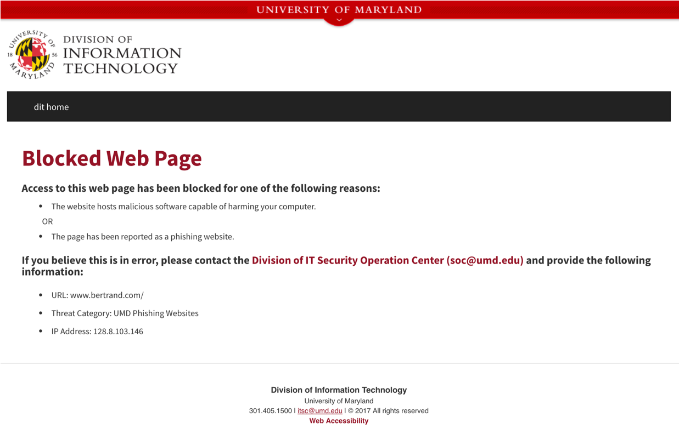

Slide 55
Palo Alto Features
URL filtering
Malware websites
Phishing
Command-and-control
Wildfire
Detect new threats
Run executables in VMs

Slide 56
Palo Alto Features
App-ID
Leverage applications in firewall rules (block RDP, block Facebook, allow HTTP/SSL)
DoS protection profiles
Protect firewalls and network gear resources
Threat Intelligence
Identify potential bad actors

Slide 57
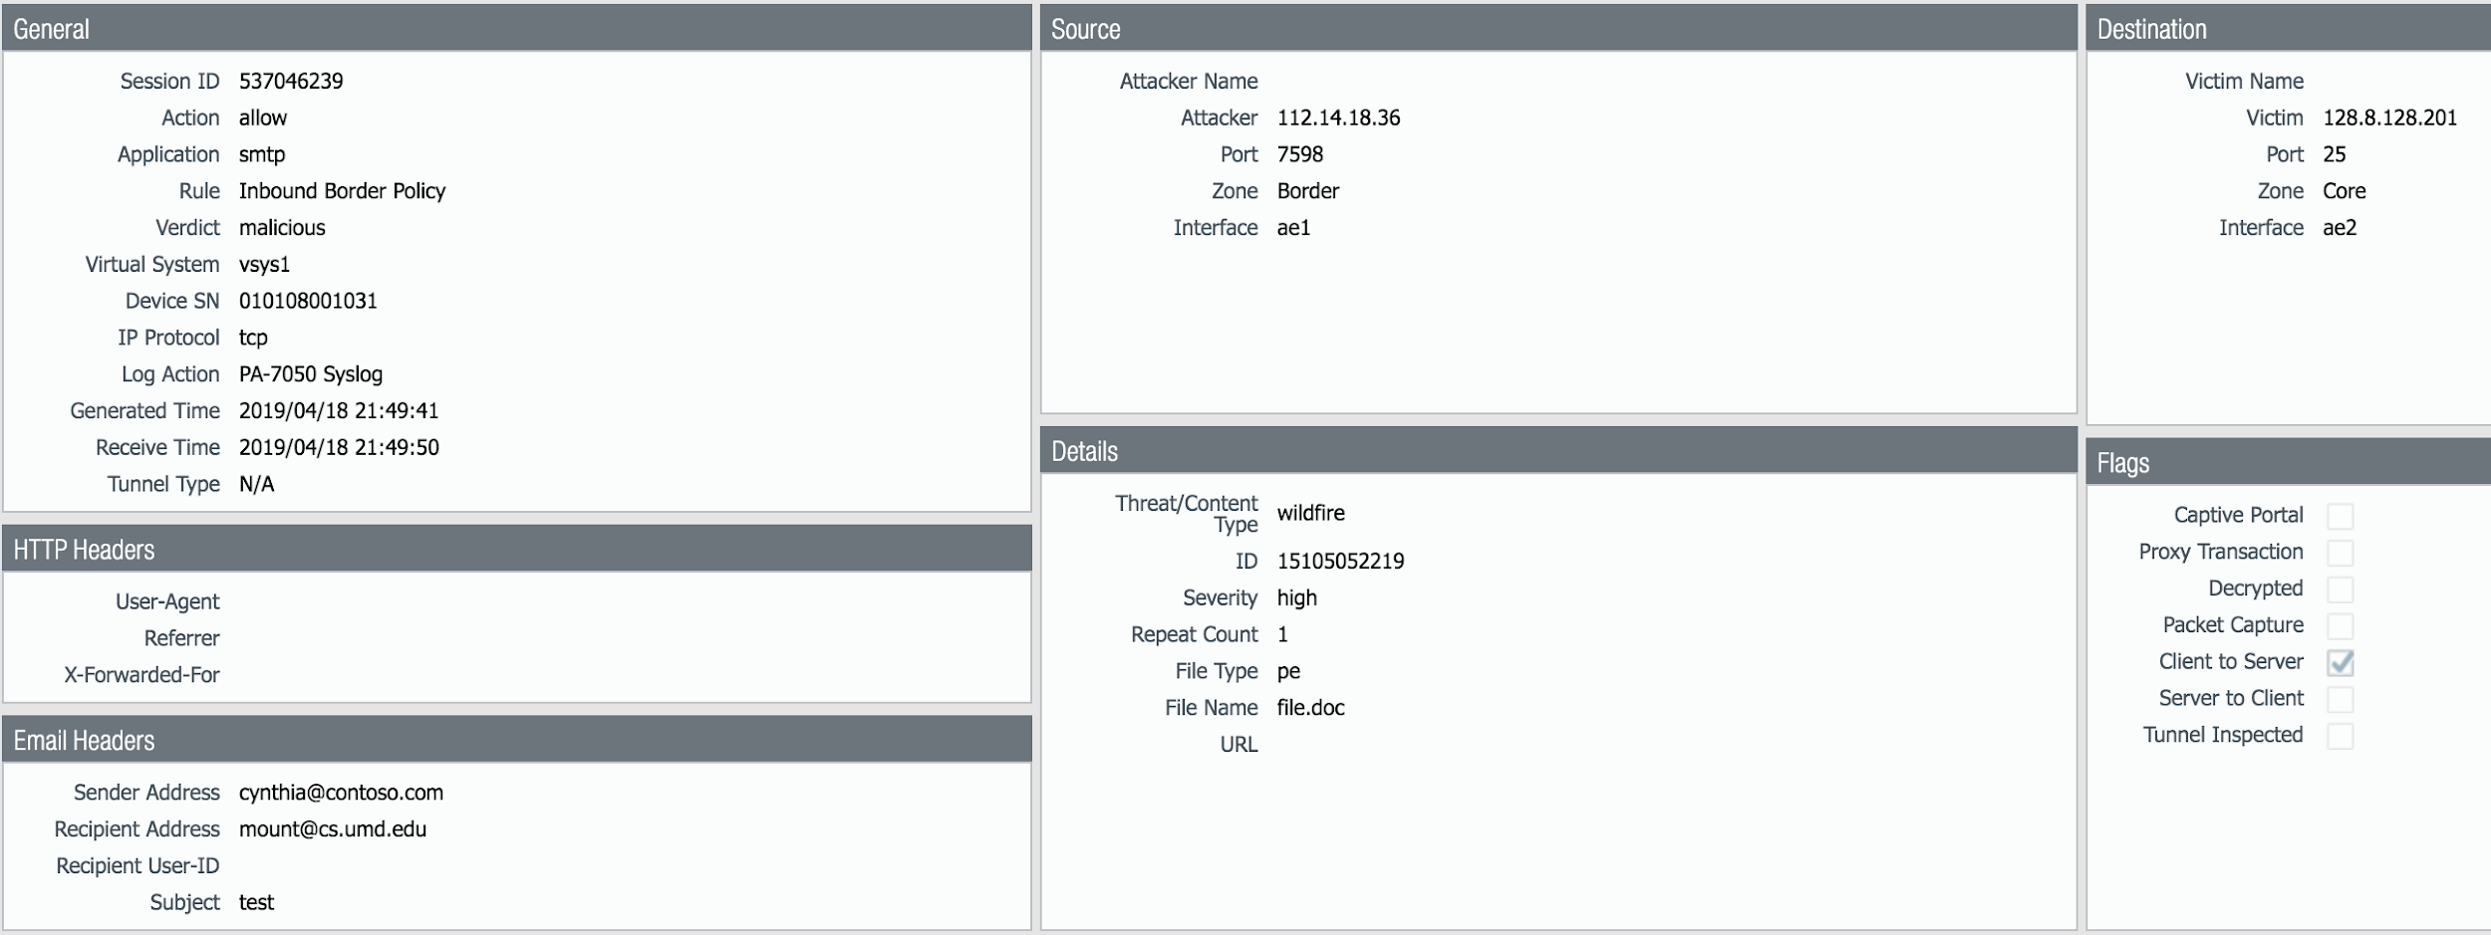
WildFire

Slide 58
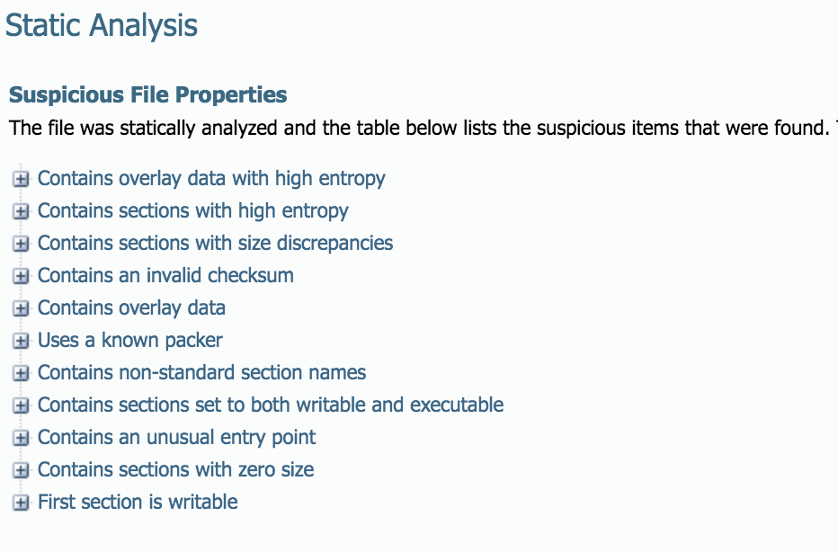
WildFire

Slide 59
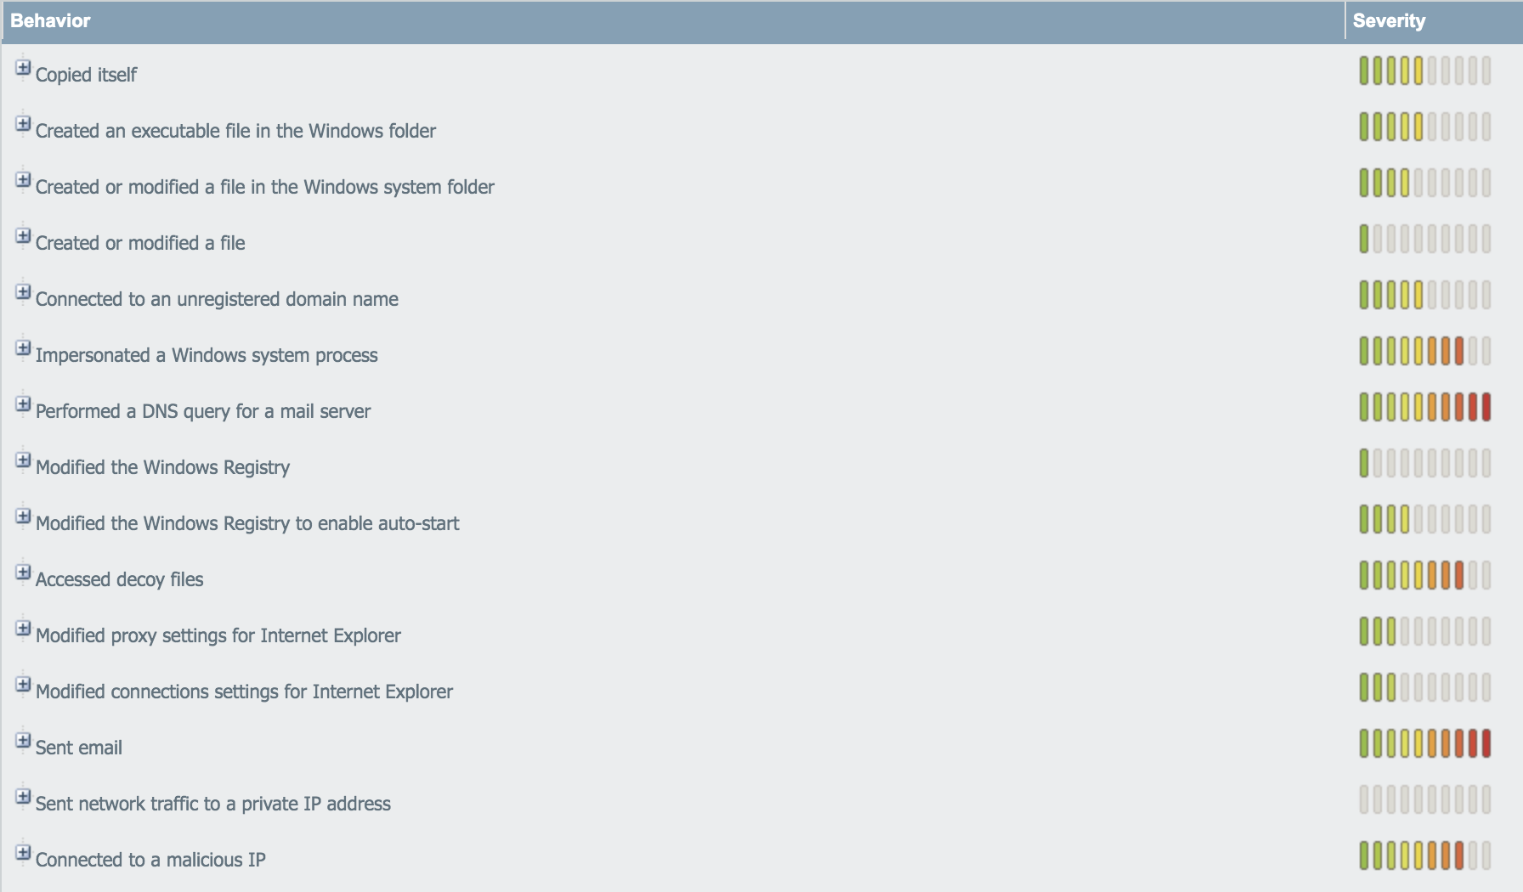
WildFire

Slide 60
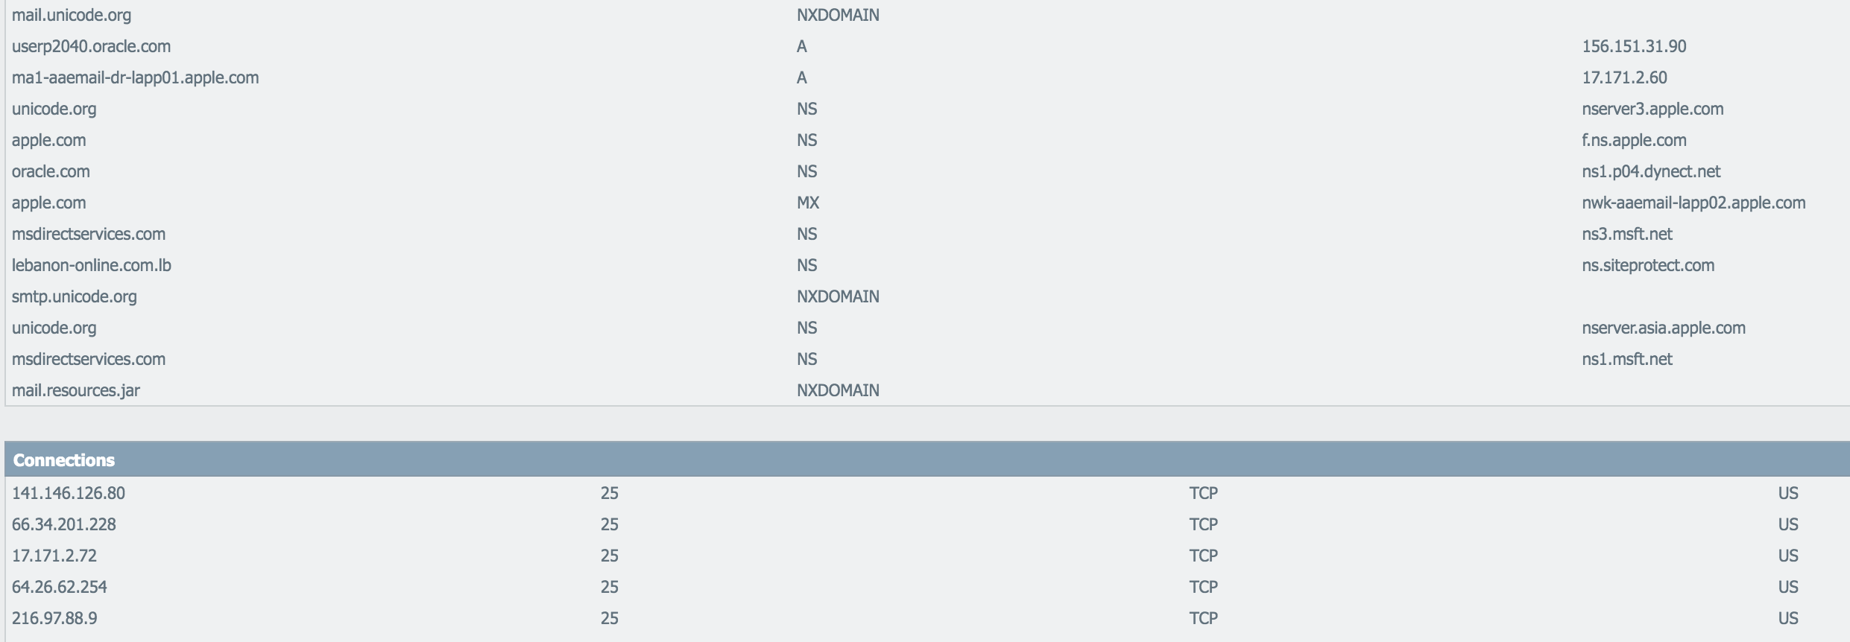
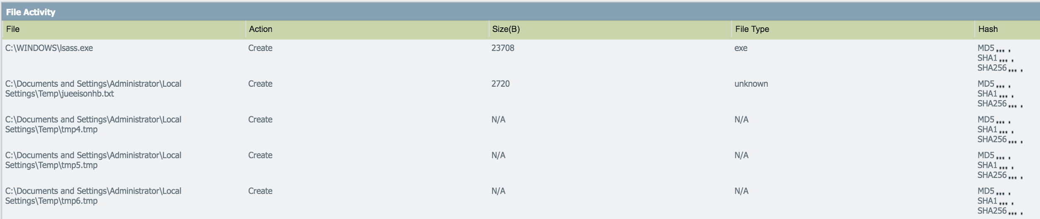
WildFire

Slide 61
Firewalling by Application
No default deny inbound at the border
Security team blocks 3389/tcp at the border to limit exposure to RDP
User sets RDP to run on 3390/tcp
Attacker = Profit!

Slide 62
Firewalling by Application
Security team blocks the RDP protocol at the border to limit exposure to RDP
User sets RDP to run on 3390/tcp
Attacker access blocked by firewall
Security team = profit!

Slide 63
Threat Intelligence
Honeypots
Bruteforce Attempts
SSH Sessions
Splunk
Palo Alto logs
Search results
IPs
URLs
IPs
URLs
Domains
Bad actors
Palo Alto?
IPs
URLs
Domains

Slide 64
WAF – Protections
SQL injection
Buffer overflows/Command injection
File upload sanity check
XSS
Session manipulation

Slide 65
WAF Issues
Tuning
You must know your web apps inside & out
Tuning
Very manual process for
Adding new rules
Reviewing logs
Tuning
Did I mention tuning?

Slide 66
ModSecurity
Original an Apache module but now supports IIS and nginx
Out of the box doesn’t support anything, you need to add rules
OWASP ModSecurity Core Rule Set - https://github.com/SpiderLabs/owasp-modsecurity-crs

Slide 67
ModSecurity Rules & Actions
SecAction \
"id:'900014', \
phase:1, \
t:none, \
setvar:'tx.brute_force_protected_urls=#/login.jsp#', \
setvar:'tx.brute_force_burst_time_slice=60', \
setvar:'tx.brute_force_counter_threshold=10', \
setvar:'tx.brute_force_block_timeout=300', \
nolog, \
pass"

Slide 68
ModSecurity Rules & Actions
SecRule REQUEST_COOKIES|!REQUEST_COOKIES:/__utm/|!REQUEST_COOKIES:/_pk_ref/|REQUEST_COOKIES_NAMES|ARGS_NAMES|ARGS|XML:/* "(^[\"'`´’‘;]+|[\"'`´’‘;]+$)" "phase:2,rev:'2',ver:'OWASP_CRS/2.2.9',maturity:'9',accuracy:'8',capture,t:none,t:urlDecodeUni,block,msg:'SQL Injection Attack: Common Injection Testing Detected',id:'981318',logdata:'Matched Data: %{TX.0} found within %{MATCHED_VAR_NAME}: %{MATCHED_VAR}',severity:'2',tag:'OWASP_CRS/WEB_ATTACK/SQL_INJECTION',tag:'WASCTC/WASC-19',tag:'OWASP_TOP_10/A1',tag:'OWASP_AppSensor/CIE1',tag:'PCI/6.5.2',setvar:'tx.msg=%{rule.msg}',setvar:tx.sql_injection_score=+%{tx.critical_anomaly_score},setvar:tx.anomaly_score=+%{tx.critical_anomaly_score},setvar:tx.%{rule.id}-OWASP_CRS/WEB_ATTACK/SQL_INJECTION-%{matched_var_name}=%{tx.0}"

Slide 69
ModSecurity Exercise
Do the ModSecurity Exercise in the Week2 Exercises document.
Take 20 minutes for this

Slide 70
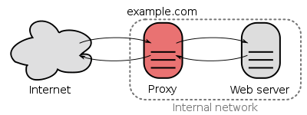
Proxies
Gateway from one network to another for a network application
Operates at layer 7
Provides obfuscation of origin, caching, logging, content scanning and censoring
Examples: IIS, nginx, squid, mod_proxy, F5

Slide 71
Why is this useful?
Reduce attack surface of behind the scenes web servers
Can filter/limit access by IP or other identifiers
Help prevent DoS/DDoS
Offload SSL encryption at the proxy (usually with SSL acceleration hardware) vs the web server behind the scenes
Cache static content to reduce backend load
Can add authentication to a server/site that otherwise does not support it

Slide 72
nginx
“engine x”
reverse proxy, load balancer, HTTP cache
open source & paid support
As of August 2019 most used webserver (32%) to Apache’s (29%)

Slide 73
NAT – Network Address Translation
A type of Layer 3 proxy
NAT router functions as a gateway
Clients inside typically get an RFC1918 address
192.168.0.0/16, 10.0.0.0/8, 172.16.0.0/12
Examples:
ICS in Windows or OSX, iptables, pf, your home router, campus wireless

Slide 74
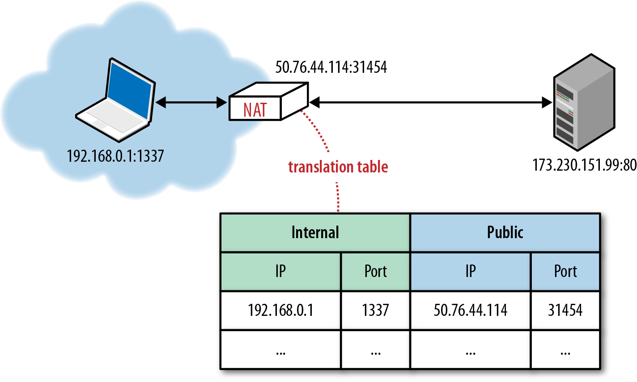
NAT

Slide 75
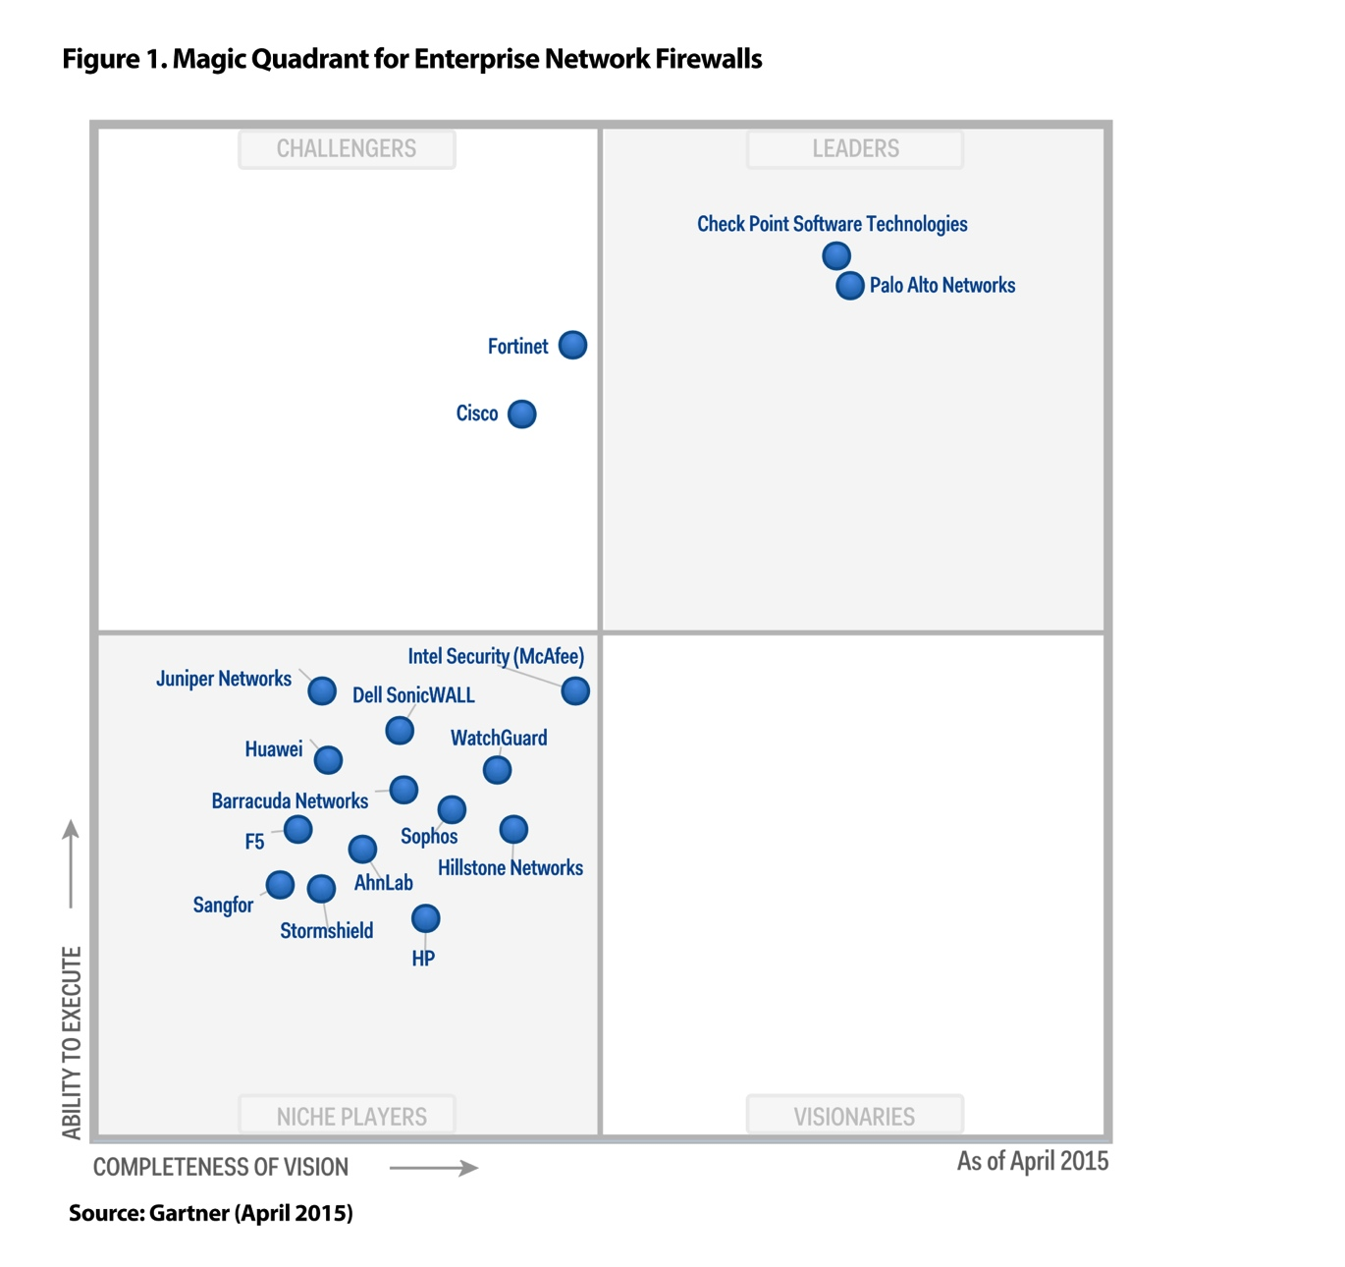
Network-based firewall vendors
Cisco
Palo Alto
Juniper
Checkpoint
And a few others

Slide 76
Host Based Firewall Vendors
Zone Alarm
Trend Micro Deep Security
And the previously mentioned:
iptables
Windows Firewall / Defender
macOS Firewall

Slide 77
Network Access Control (NAC)
Solution to address end point security and user authentication
Computer wants to connect to a network but it is put in “timeout” (aka a captive portal/network/VLAN) until the computer meets security requirements
AV installed
Patches installed
etc
A way to handle user authentication
Agent based or agentless, agent is more accurate
$$$: Cisco ISE (Identity Services Engine), ForeScout, Aruba ClearPass, others
OSS: PacketFence

Slide 78
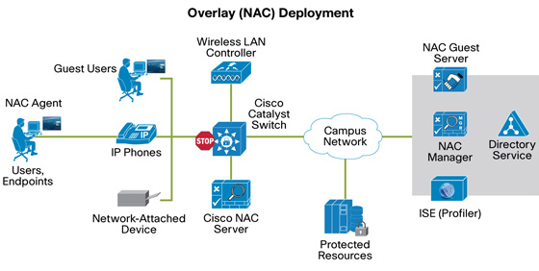
Network Access Control (NAC)

Slide 79
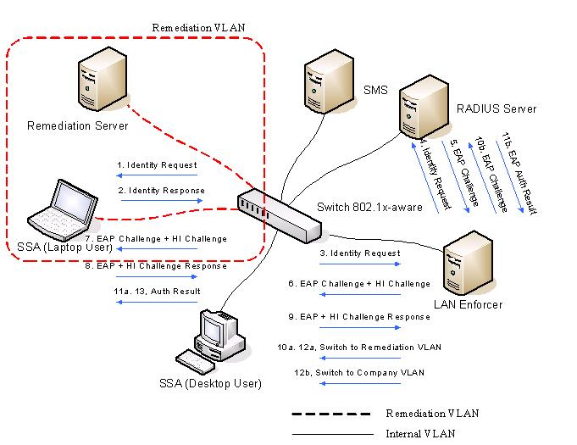
Network Access Control (NAC)

Slide 80
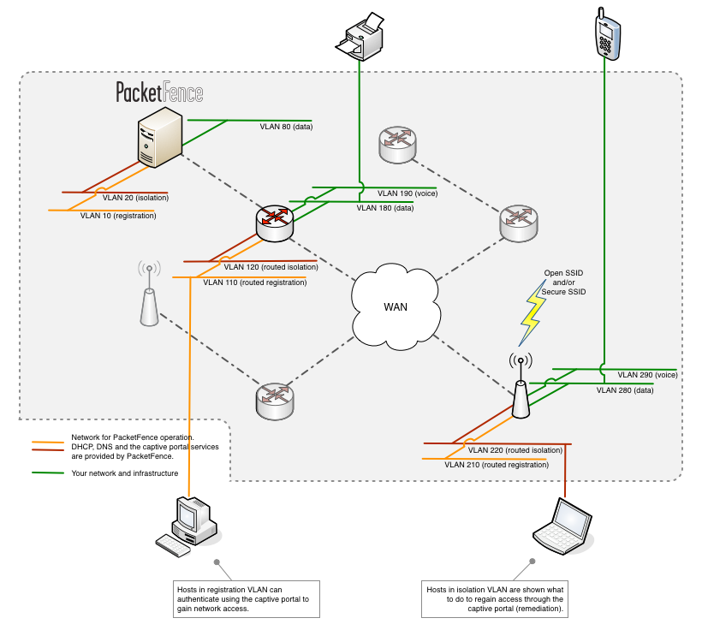

Slide 81
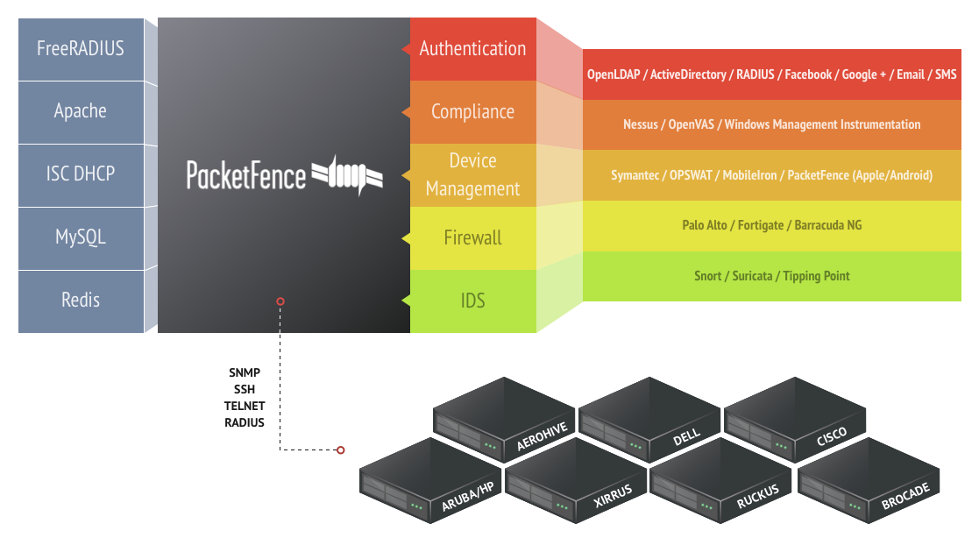

Slide 82
Sensible Firewall Policy
Default deny
Driven by organizational policy
Defined in simple terms
Ex: Web servers allow HTTP/HTTPS to the world
Ex: Web servers allow SSH for admin purposes from VPN
Makes use of reusable objects
Ex: HTTP and HTTPS are defined as an object called “web-ports”
Ex: Project X’s web servers are defined as “project-x-webservers”
Makes use of descriptive comments
Ex: “This rule is to allow access from Project X’s web servers to communicate with their Database server”

Slide 83
Default Deny
Without a default deny firewall rule any system on the internet with a “public” IP address (NOT an RFC1918 IP address) are accessible on any port by anyone in the world.
Significant risk to
Unpatched systems
Open administrative ports

Slide 84
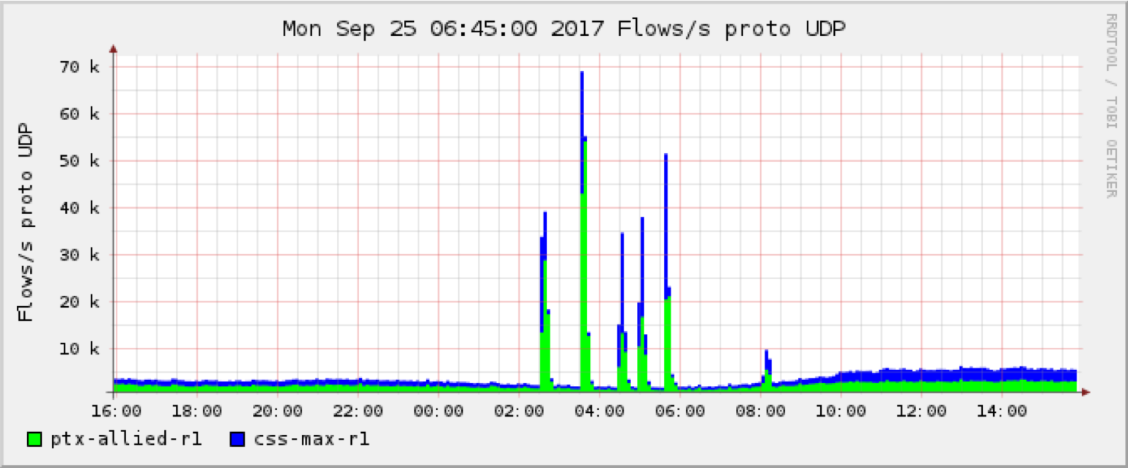
Default Deny

Slide 85

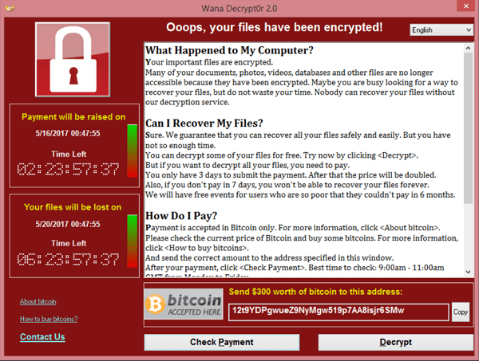

Default Deny
Significantly reduces risk
Helps prevent spreading of botnets/worms

Slide 86
Default Deny
Hosts that do not need to accept inbound connections are protected by the default deny
User desktops, printers, IoT
Host that need to accept inbound connections from the outside world can with an allow rule
Web/mail/SSH servers
"Easy” process to request exemptions for these

Slide 87
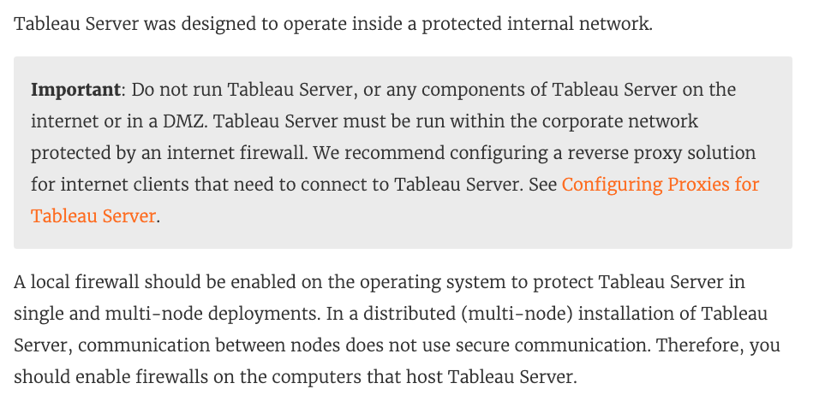

Slide 88
Sensible Rule/Object Creation
To keep rulesets manageable
Use objects/objects groups where possible
Combine rules where possible
Good network/IP management/planning is really helpful here

Slide 89
Clients to DB server (10.20.0.2)
Source: 10.1.1.2 to Dest: 10.20.0.2 port 3306
Source: 10.1.1.3 to Dest: 10.20.0.2 port 3306
Source: 10.1.1.4 to Dest: 10.20.0.2 port 3306
Source: 10.1.1.5 to Dest: 10.20.0.2 port 3306
Source: 10.1.2.10 to Dest: 10.20.0.2 port 3306
Source: 10.1.2.3 to Dest: 10.20.0.2 port 3306
vs
Source: 10.1.1.2, 10.1.1.3, 10.1.1.4, 10.1.1.5, 10.1.2.10, 10.1.2.3
Dest: 10.20.0.2
Port: 3306
Imagine you are migrating to a new DB server

Slide 90
Clients to DB server (10.20.0.2)
10.20.10.2
Source: 10.1.1.2 to Dest: 10.20.0.2 port 3306 10.20.10.2
Source: 10.1.1.3 to Dest: 10.20.0.2 port 3306 10.20.10.2
Source: 10.1.1.4 to Dest: 10.20.0.2 port 3306 10.20.10.2
Source: 10.1.1.5 to Dest: 10.20.0.2 port 3306 10.20.10.2
Source: 10.1.2.10 to Dest: 10.20.0.2 port 3306 10.20.10.2
Source: 10.1.2.3 to Dest: 10.20.0.2 port 3306 10.20.10.2
vs
Source: 10.1.1.2, 10.1.1.3, 10.1.1.4, 10.1.1.5, 10.1.2.10, 10.1.2.3
Dest: 10.20.0.2 10.20.10.2
Port: 3306
Imagine you are adding a new DB server

Slide 91
Clients to DB servers
Source: 10.1.1.2 to Dest: 10.20.10.2 port 3306
Source: 10.1.1.3 to Dest: 10.20.10.2 port 3306
Source: 10.1.1.4 to Dest: 10.20.10.2 port 3306
Source: 10.1.1.5 to Dest: 10.20.10.2 port 3306
Source: 10.1.2.10 to Dest: 10.20.10.2 port 3306
Source: 10.1.2.3 to Dest: 10.20.10.2 port 3306
vs
Source: 10.1.1.2, 10.1.1.3, 10.1.1.4, 10.1.1.5, 10.1.2.10, 10.1.2.3
Dest: 10.20.10.2, 10.20.10.3
Port 3306
Imagine you are adding yet another new DB server
X2 for each rule to add new server at 10.20.10.3
Now 12 rules

Slide 92
Create Objects
“web-servers” with list: 10.1.1.2, 10.1.1.3, 10.1.1.4, 10.1.1.5, 10.1.2.10, 10.1.2.3
“db-servers” with list: 10.20.10.2, 10.20.10.3, 10.20.10.4
“mgmt-servers” with list 10.0.0.2

Slide 93
Client to DB servers
18 x rules like “Source: 10.1.1.2 to Dest: 10.20.10.2 port 3306”
vs
Source: web-servers
Dest: db-servers
Port: 3306
Imagine you are adding management via SSH

Slide 94
SSH to DB and Web Servers
9 x rules like “Source: 10.0.0.2 to Dest: 10.1.1.2 port 22”
(6 web servers + 3 DB servers)
vs
Source: mgmt-servers
Dest: web-servers, db-servers
Port: 22

Slide 95
But mgmt-servers only has one host!
So did the DB servers when we started… ☺
Plan for the long term
Adding high availability, redundancy, etc….
This also provides better readability of rules
“What’s 10.0.0.2?”

Slide 96
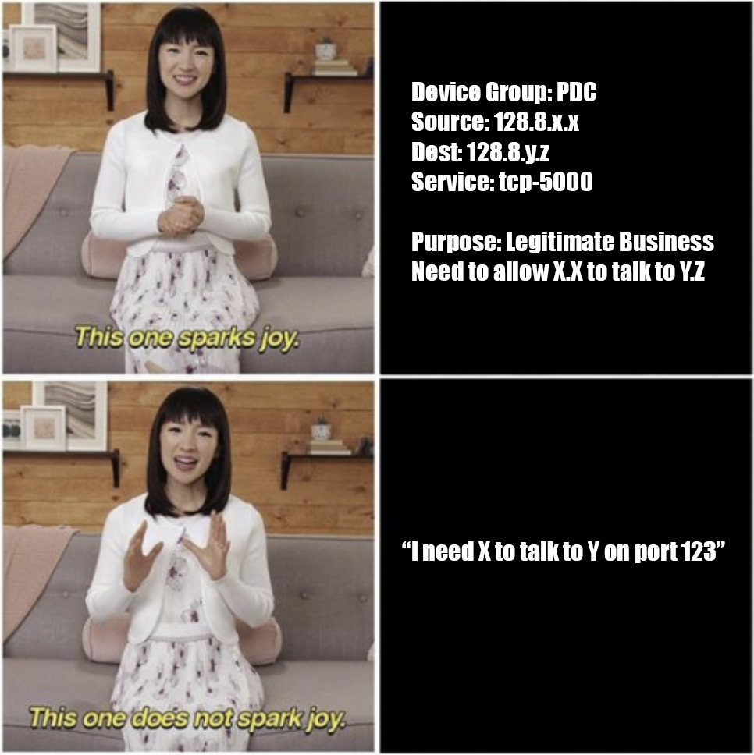
Requesting Firewall Rules

Slide 97
Separation of Duties
Requestor
Sysadmin
Approver
Security
Manager
Implementer
SOC

Slide 98
Why do we do this?
Reduces risk
Reduces error
Supports accountability

Slide 99
Request
Purpose: Legitimate business need to connect App Server to the Database server
Rule:
Device Group: PDC
Source: 128.8.x.x (App Server)
Destination: 128.8.y.y (Database Server)
Service: tcp-1433 (SQL Server)

Slide 100

Result

Slide 101
Request
Purpose: Make it easier for admins to remotely manage the server from anywhere
Rule:
Device Group: PDC
Source: any
Destination: 128.8.a.b (App Server)
Service: tcp-443 (Admin Web UI)
“and” really means ANY IP – across campus, China, Antarctica, anywhere…

Slide 102

Result

Slide 103
Result
Redirect the requestor using the VPN for access or a more narrowly defined source IP list
The VPN can be accessed from anywhere!

Slide 104
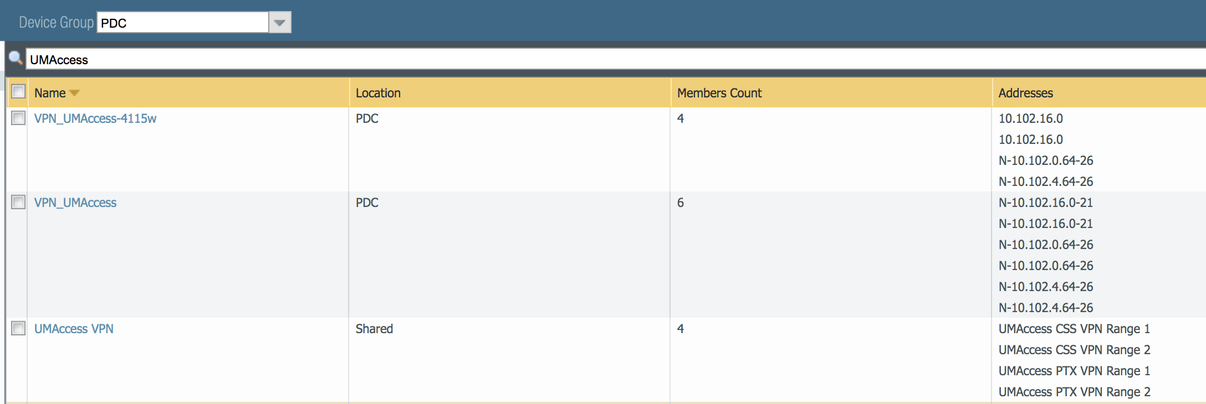
Firewall Rule Clean up
Rules edited after implementation
System retired? Firewall rules should retired as well.
Duplicate groups/rules should be removed.

Slide 105
Network Segmentation
Remember the Target compromise from “Anatomy of an attack”?
Should a network be ”flat” and anything can access anything else on the network?
“Hard exterior but a soft chewy inside…”
(content on next slide from https://www.cisa.gov/sites/default/files/publications/layering-network-security-segmentation_infographic_508_0.pdf)

Slide 106
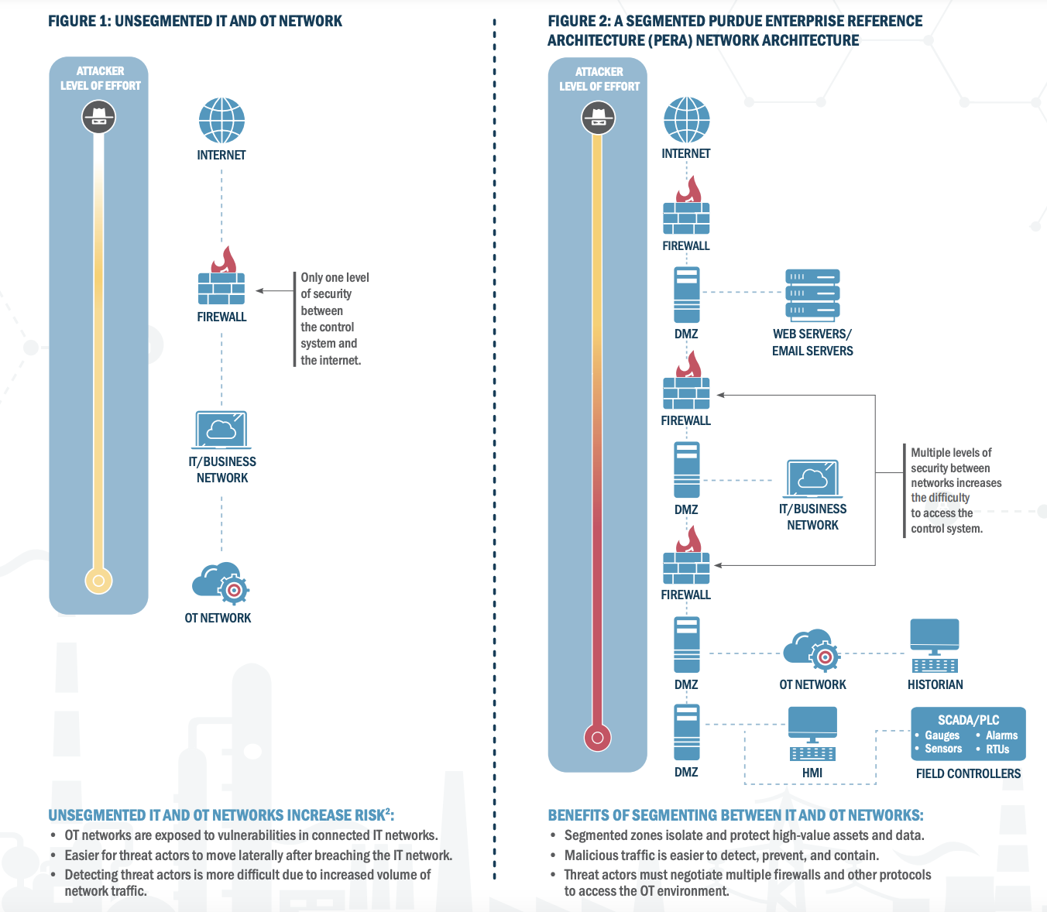

Slide 107
And now for something completely different…
Networking

Slide 108
Relationships are currency

Slide 109
Relationships
Initiate
Inquire
Invest
Influence

Slide 110
Build your network
Classmates
Coworkers
Industry functions/conferences
Information Sharing and Analysis Centers (ISACs)
User Groups
LinkedIn/Twitter/social media
Get out there and talk to people!

Slide 111
